Slide 1
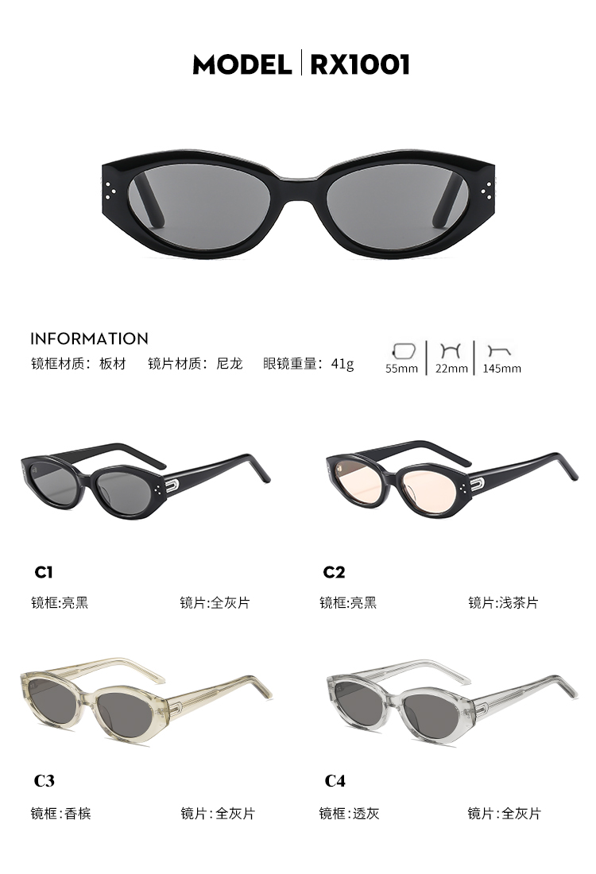
GM DADA

Slide 2
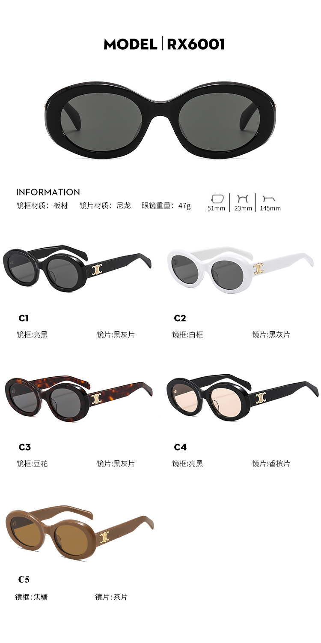
CELINE CL40194U

Slide 3
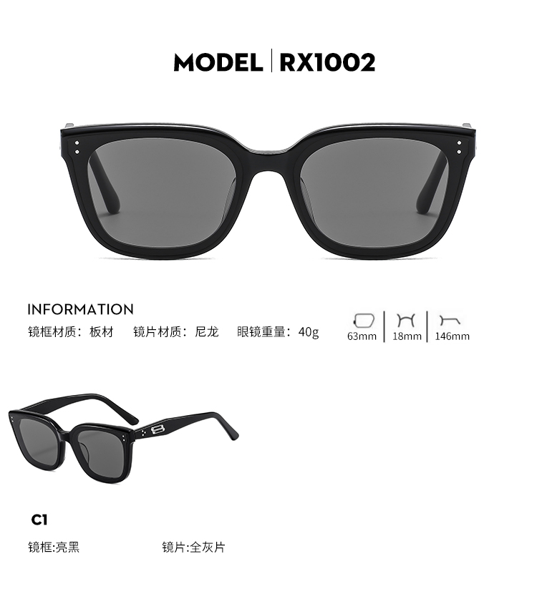
GM TOTE

Slide 4
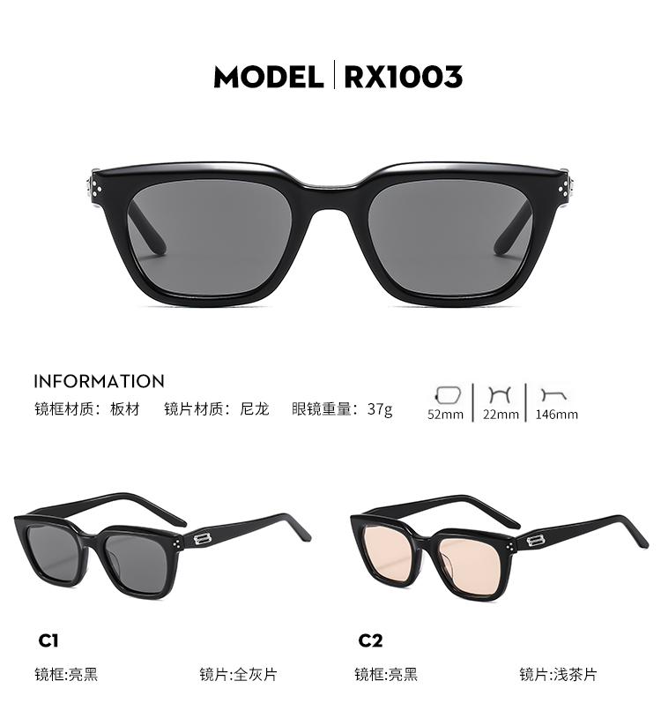
GM HOVO

Slide 5
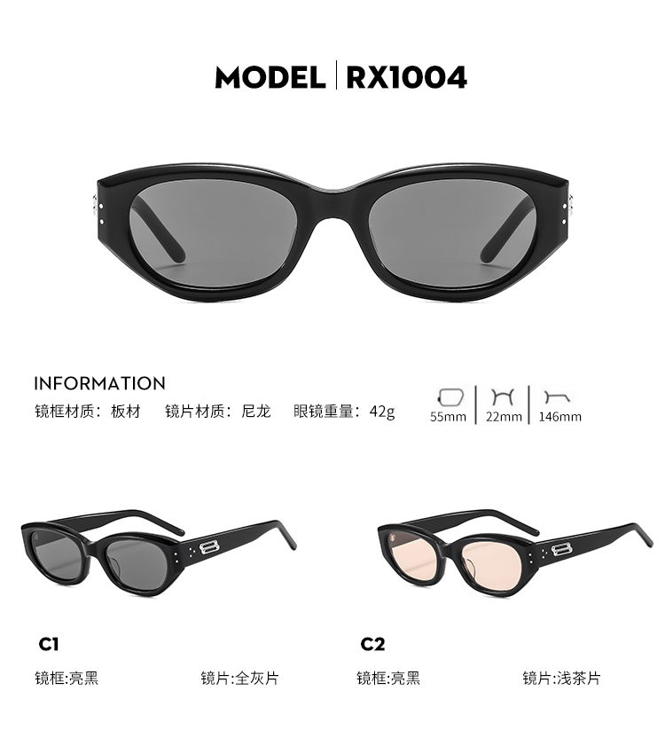
GM BENVN

Slide 6

GM ROCOCO

Slide 7

GM MOLTA

Slide 8
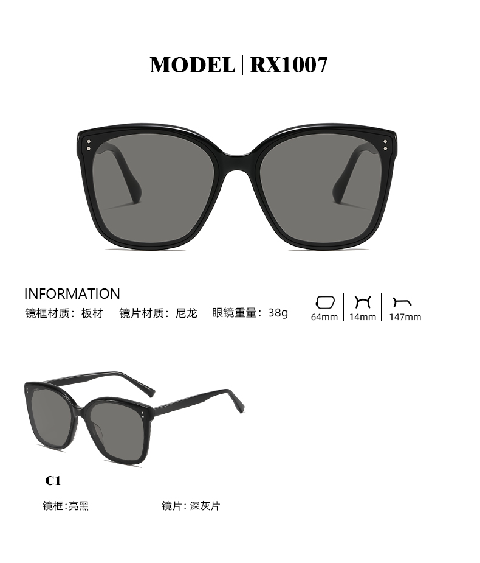
GM GABEE

Slide 9
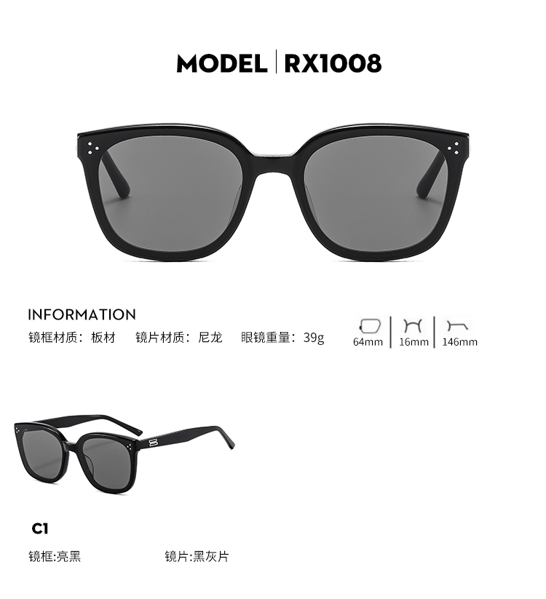
GM BY

Slide 10

GM JACKIE

Slide 11
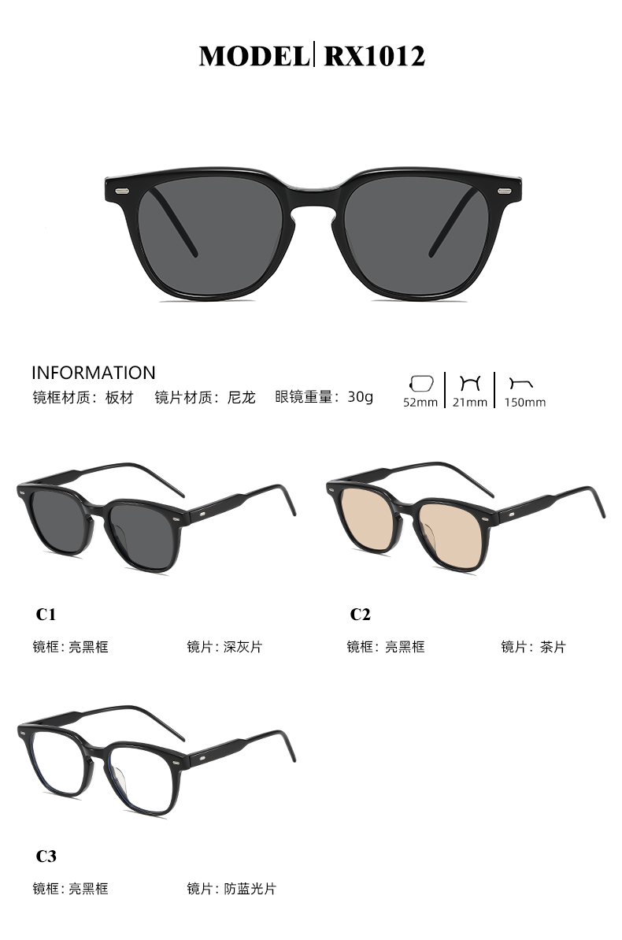
GM KUBO

Slide 12
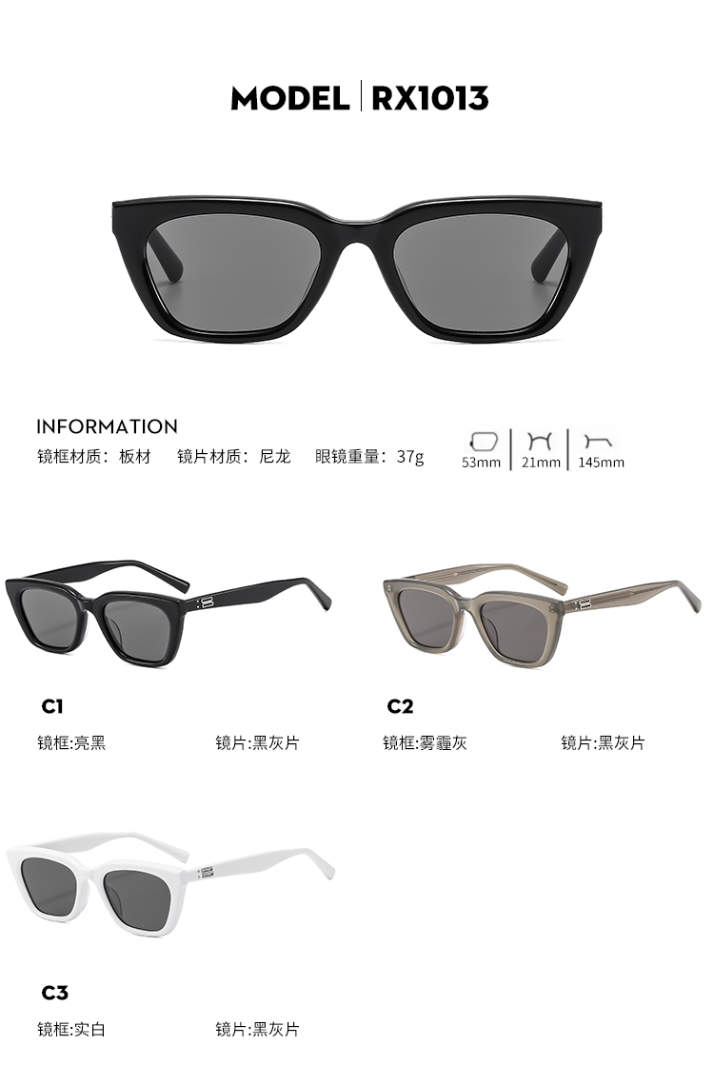
GM HUE

Slide 13
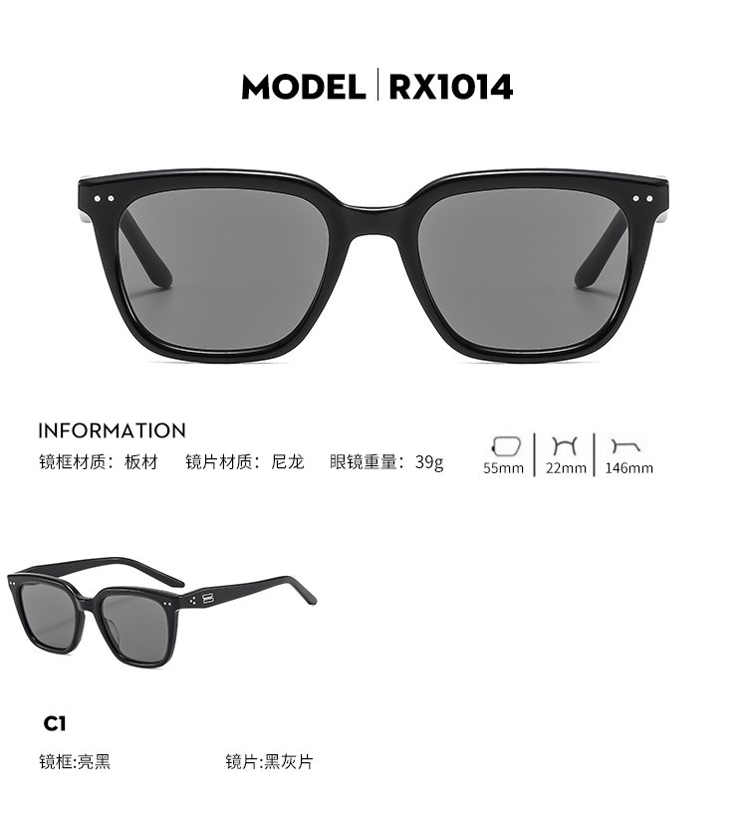
GM NUBO

Slide 14
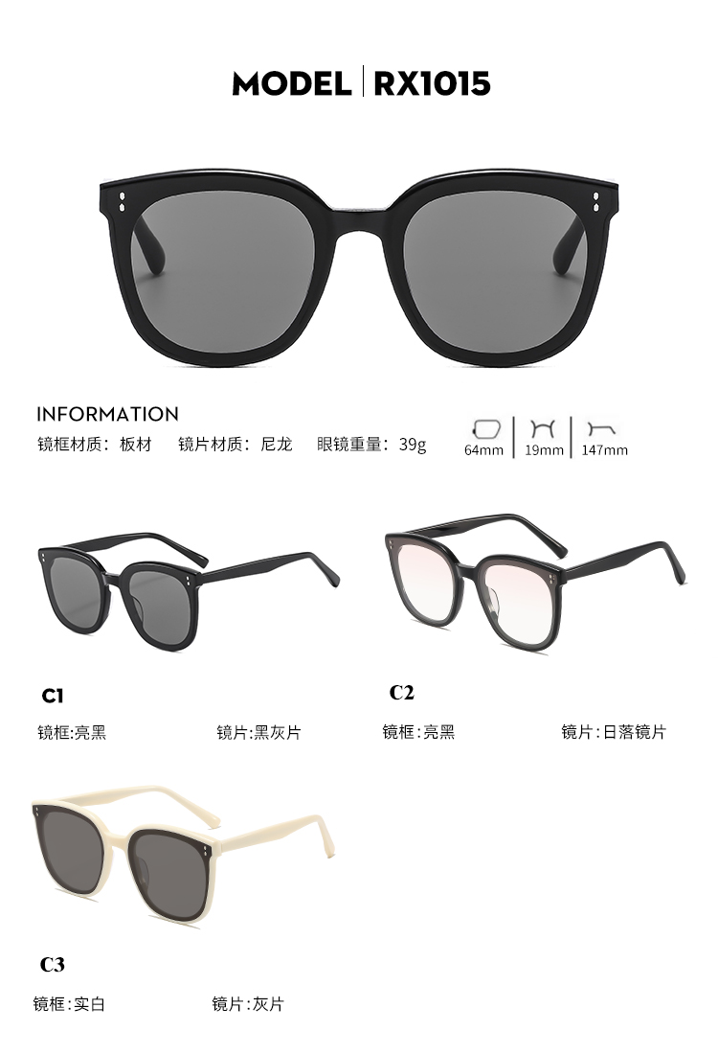
GM ROSY

Slide 15

GM SALG

Slide 16
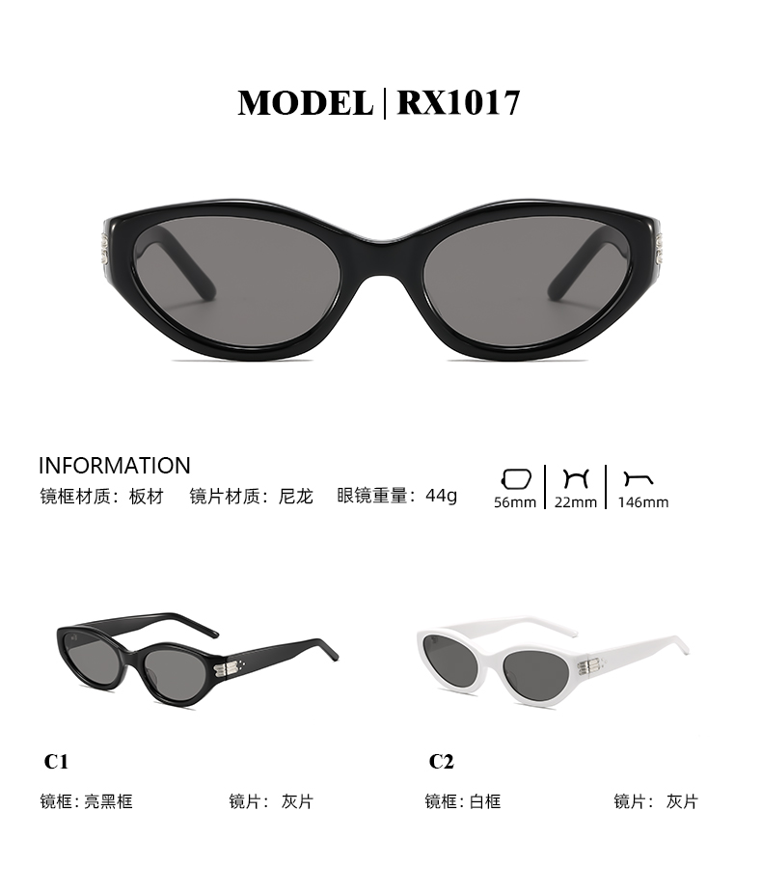
GM KIKO

Slide 17

GM LIN

Slide 18

GM MM-107

Slide 19
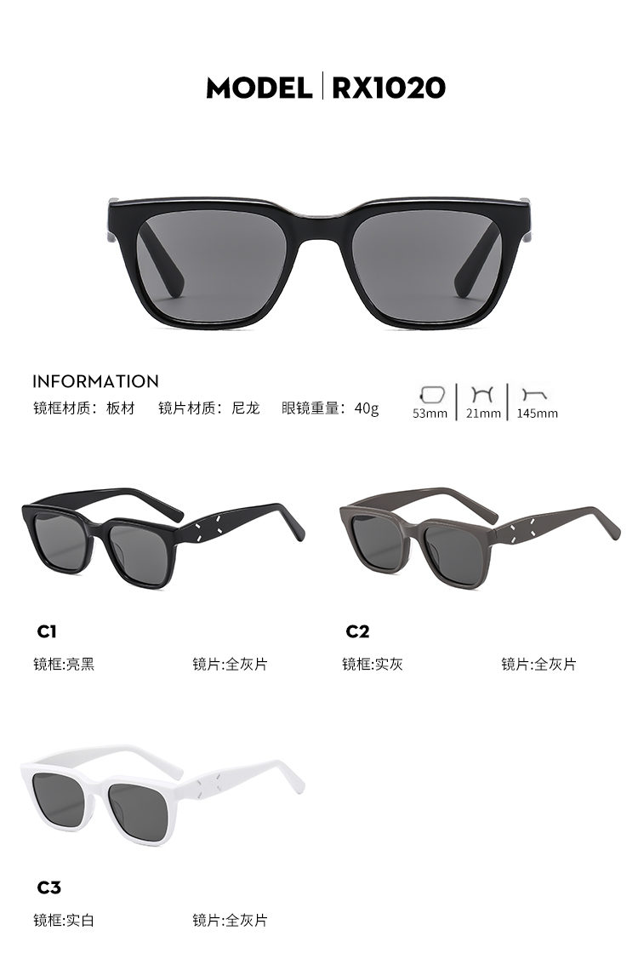
GM MM-110

Slide 20
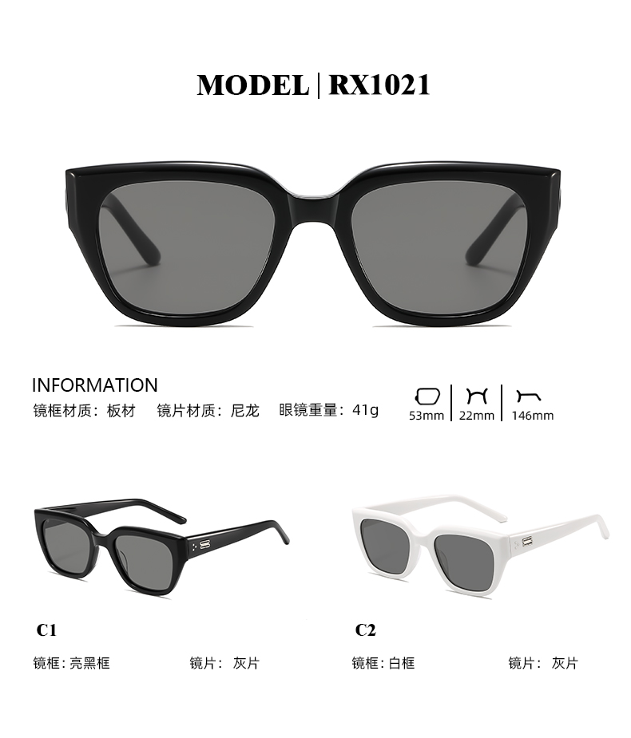
GM NABI

Slide 21

GM NONN

Slide 22
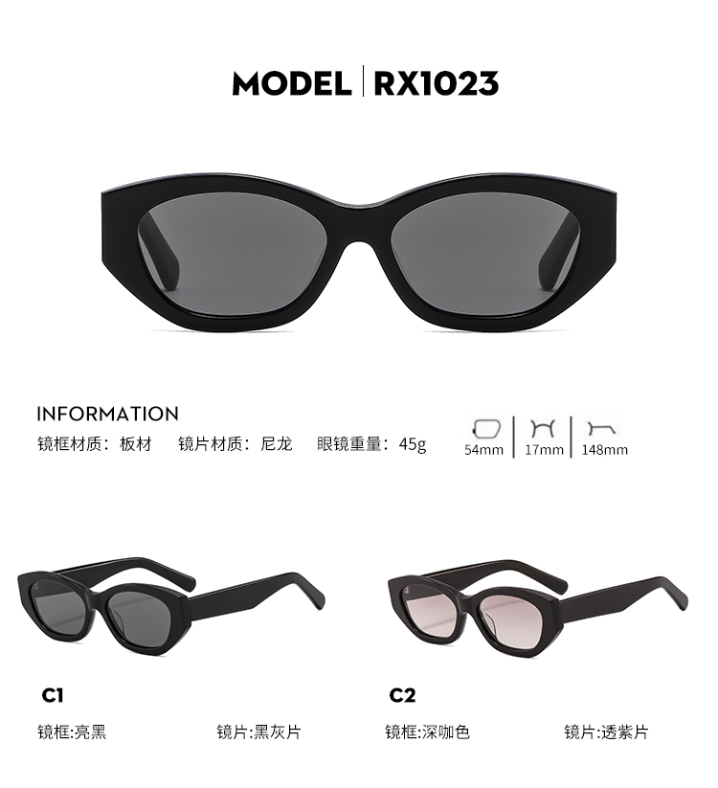
LURE

Slide 23


Slide 24

Heien Keller

Slide 25
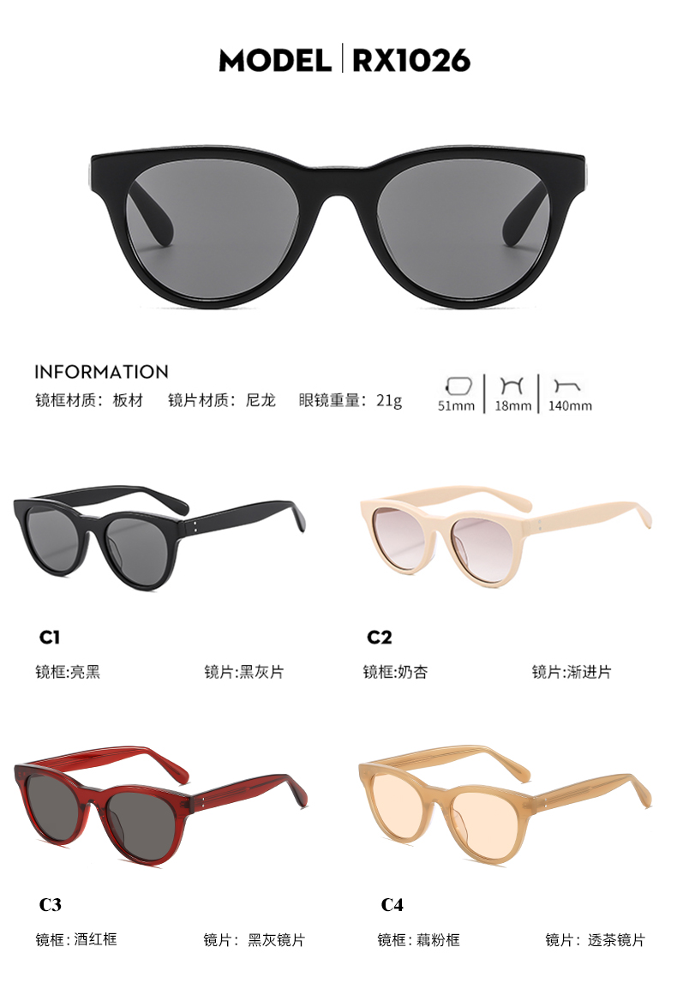
LOWRY

Slide 26
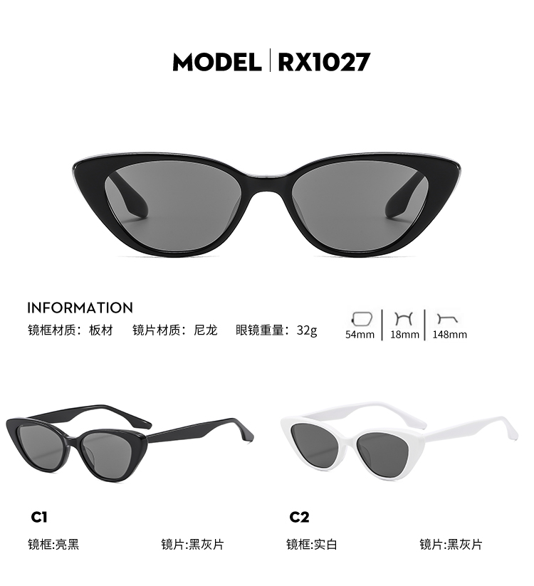
GM CRELLA

Slide 27

CELINE

Slide 28
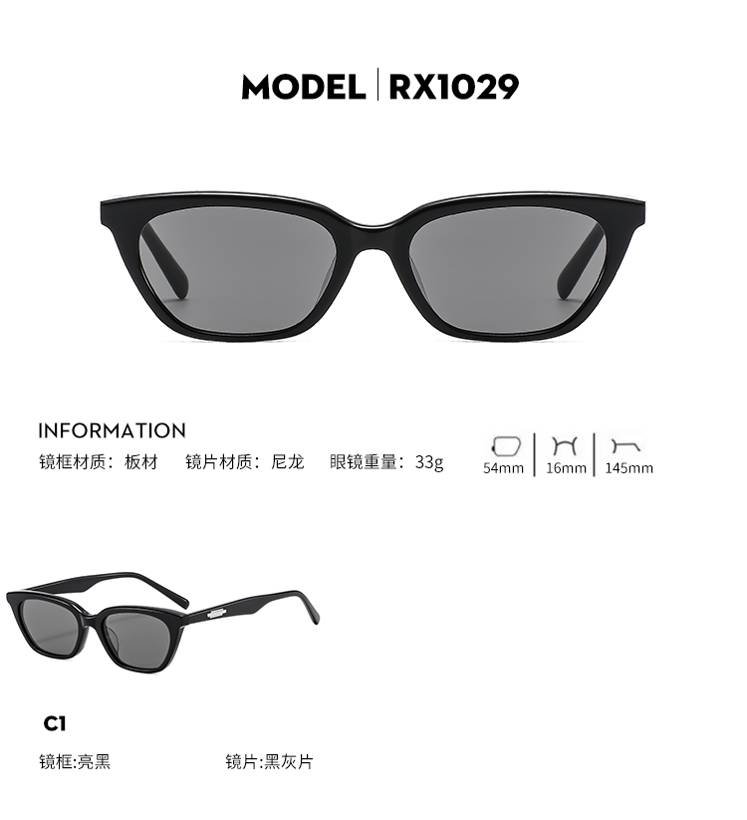
GM LOTI

Slide 29
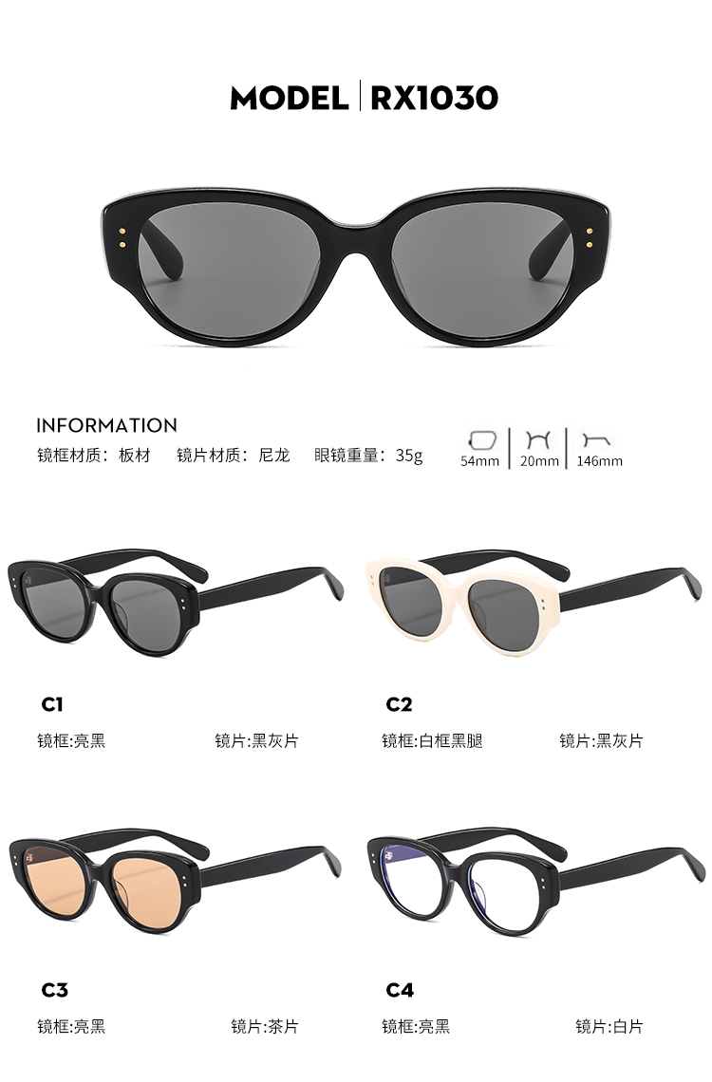
RED ZONE.SUP

Slide 30
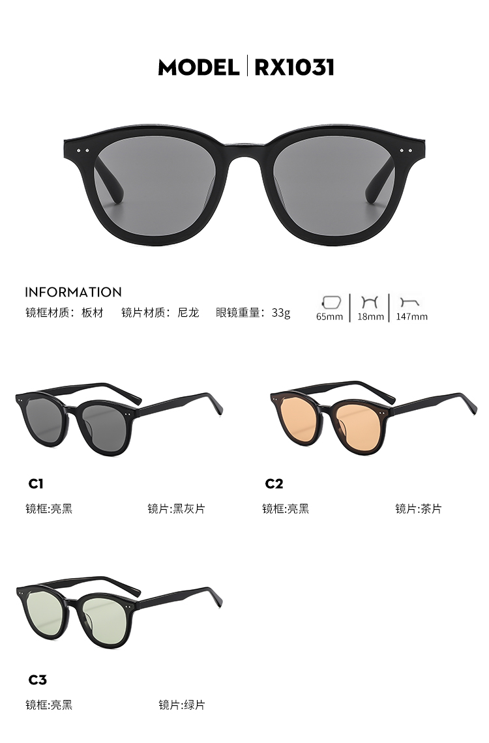
LANG

Slide 31
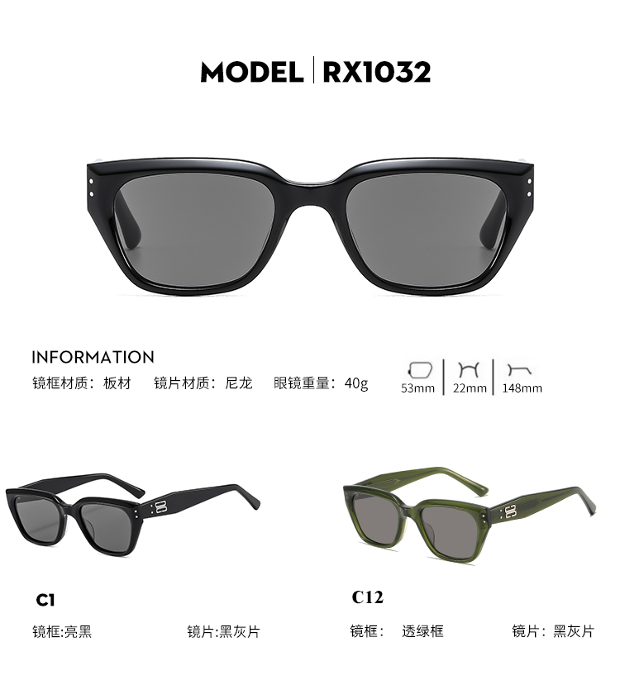
GM NADA

Slide 32

KRISTEN R

Slide 33
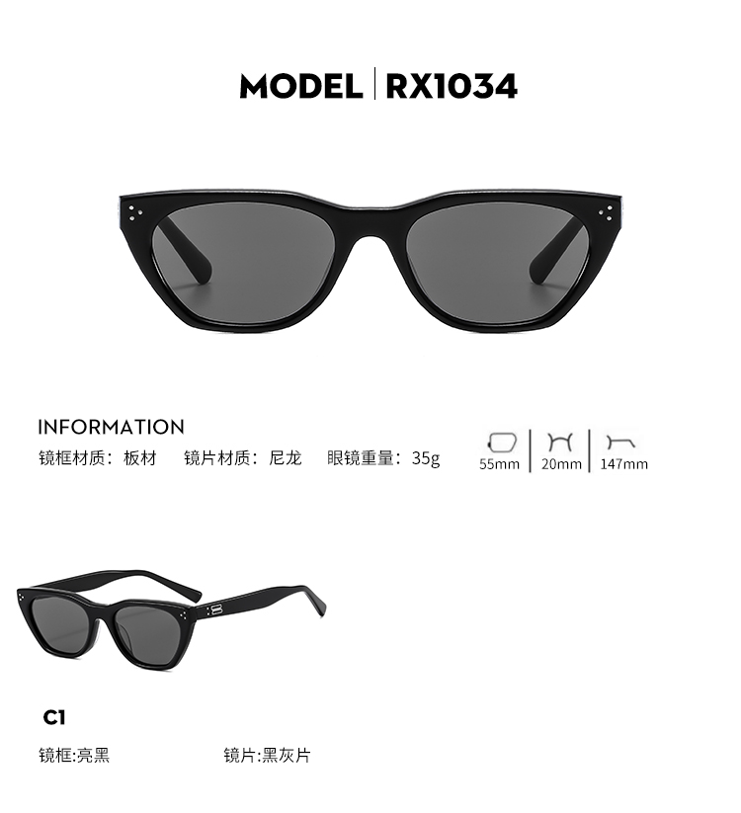
COOKIE

Slide 34
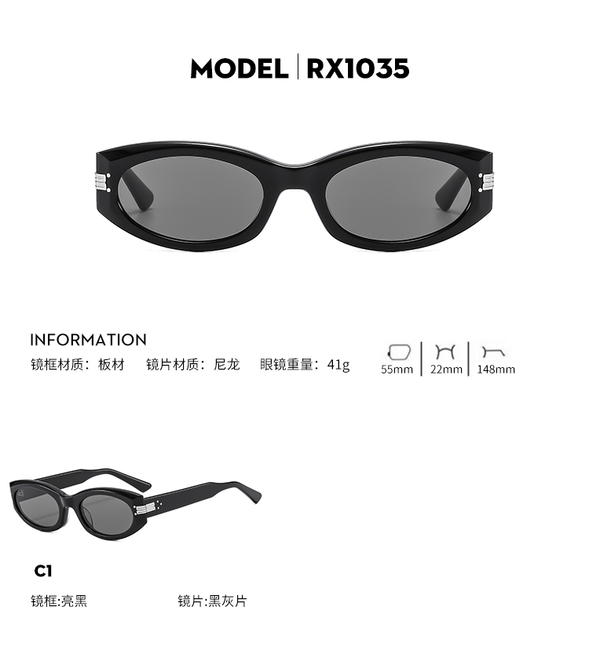
GM MASS

Slide 35

CELINE

Slide 36
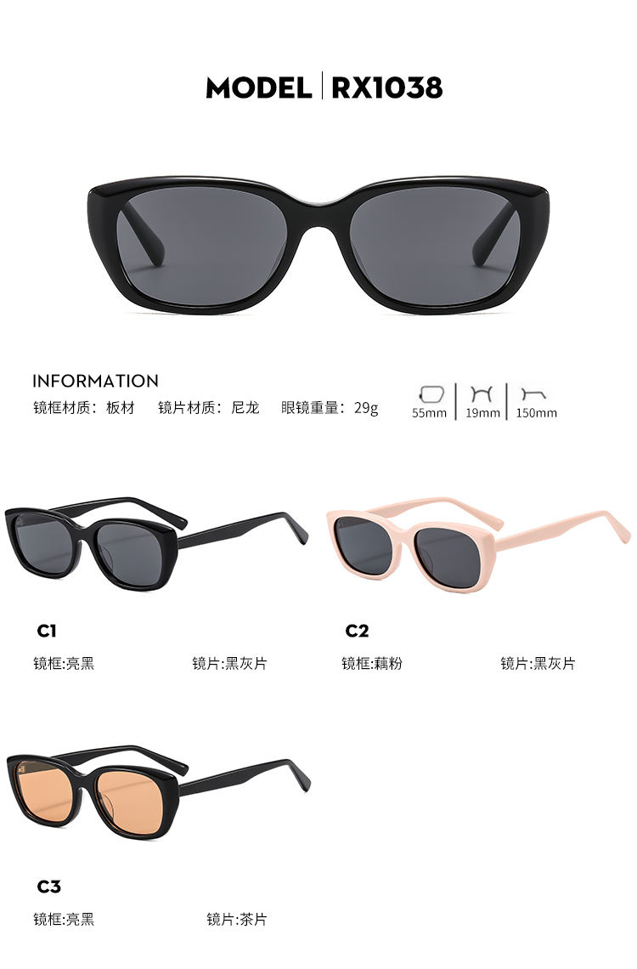
MS3609

Slide 37

CELINE

Slide 38

FAKE ME LOW

Slide 39

MS3077

Slide 40
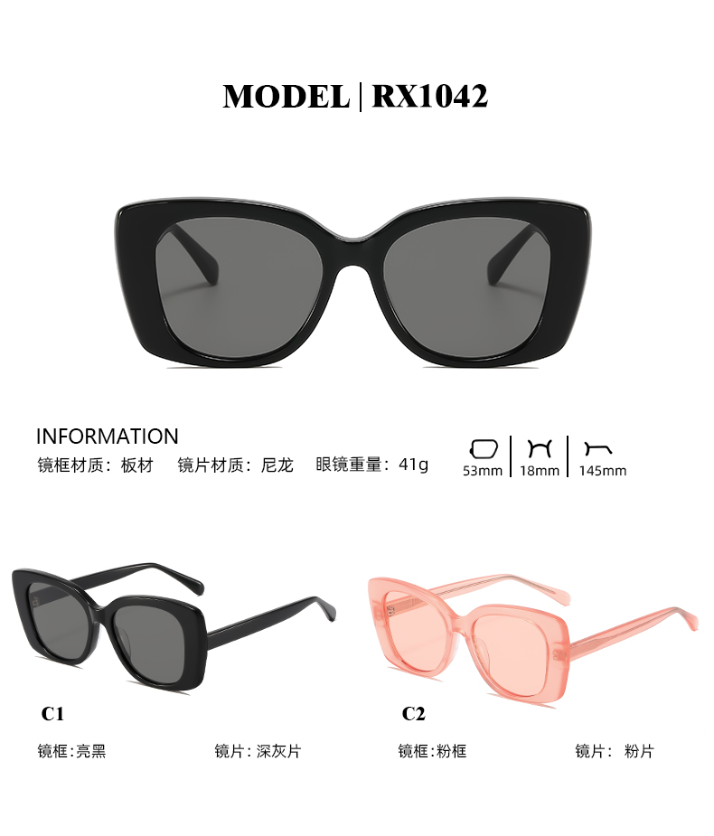
CHANEL5504

Slide 41
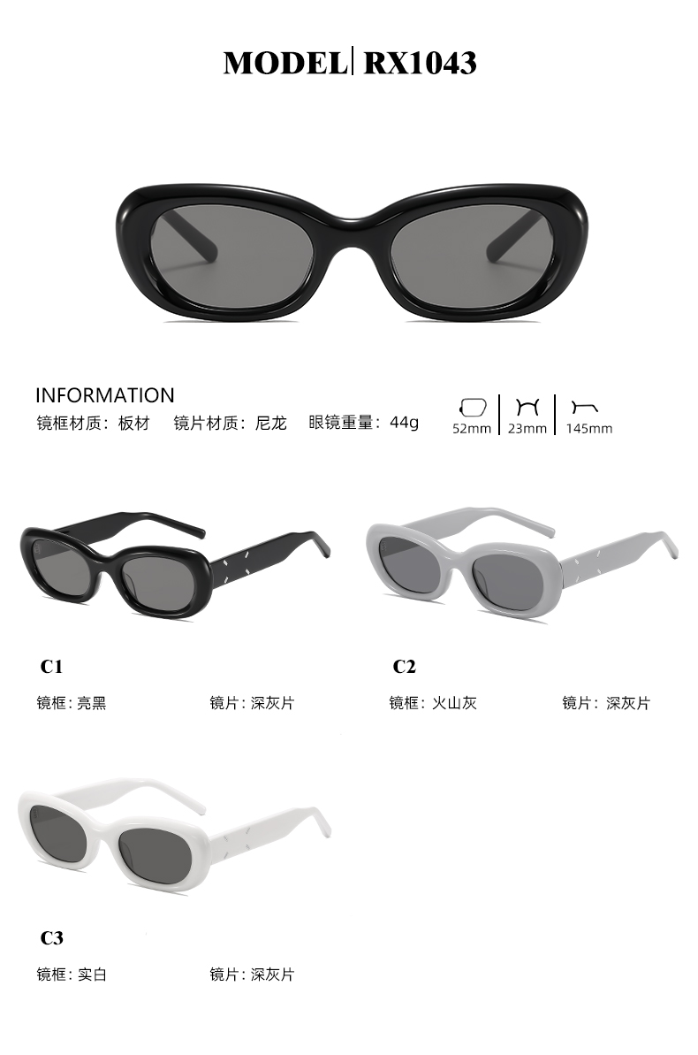
GM MM004

Slide 42
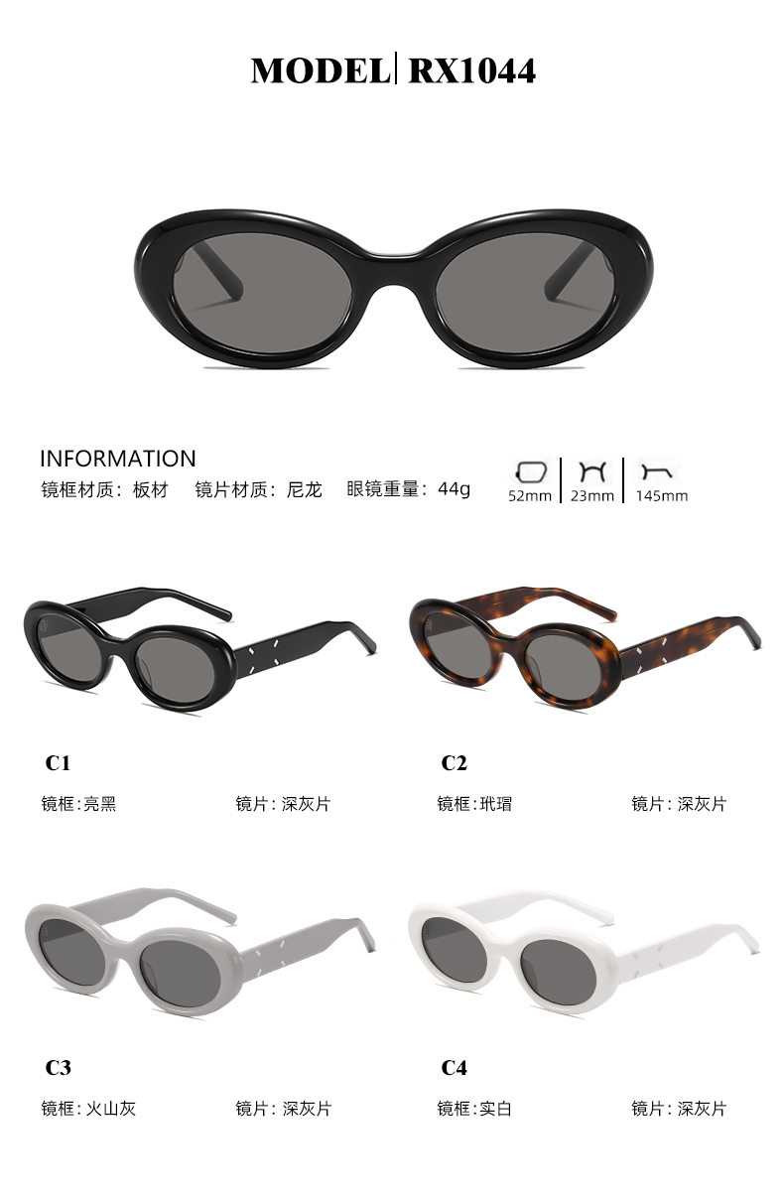
GM MM005

Slide 43
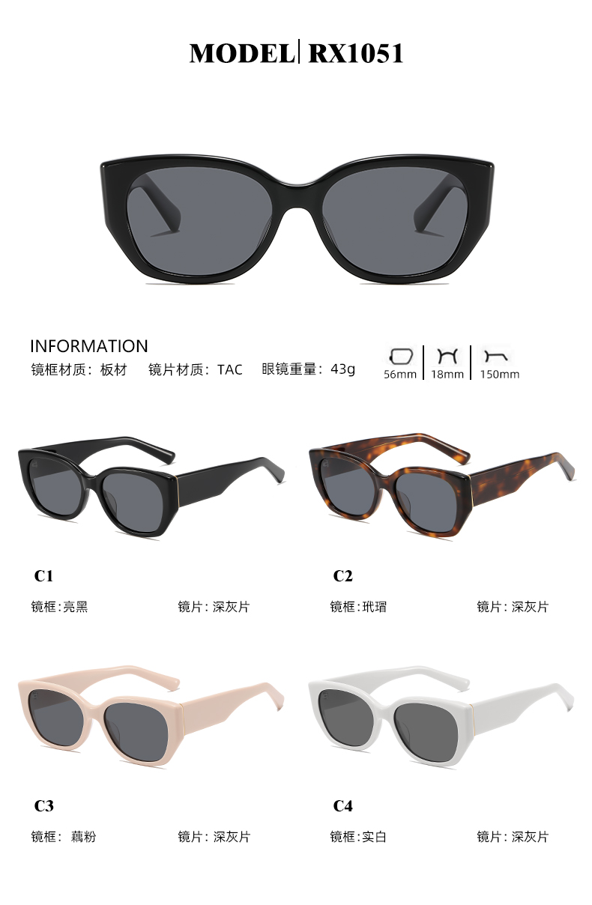
3195

Slide 44

MIUMIU

Slide 45
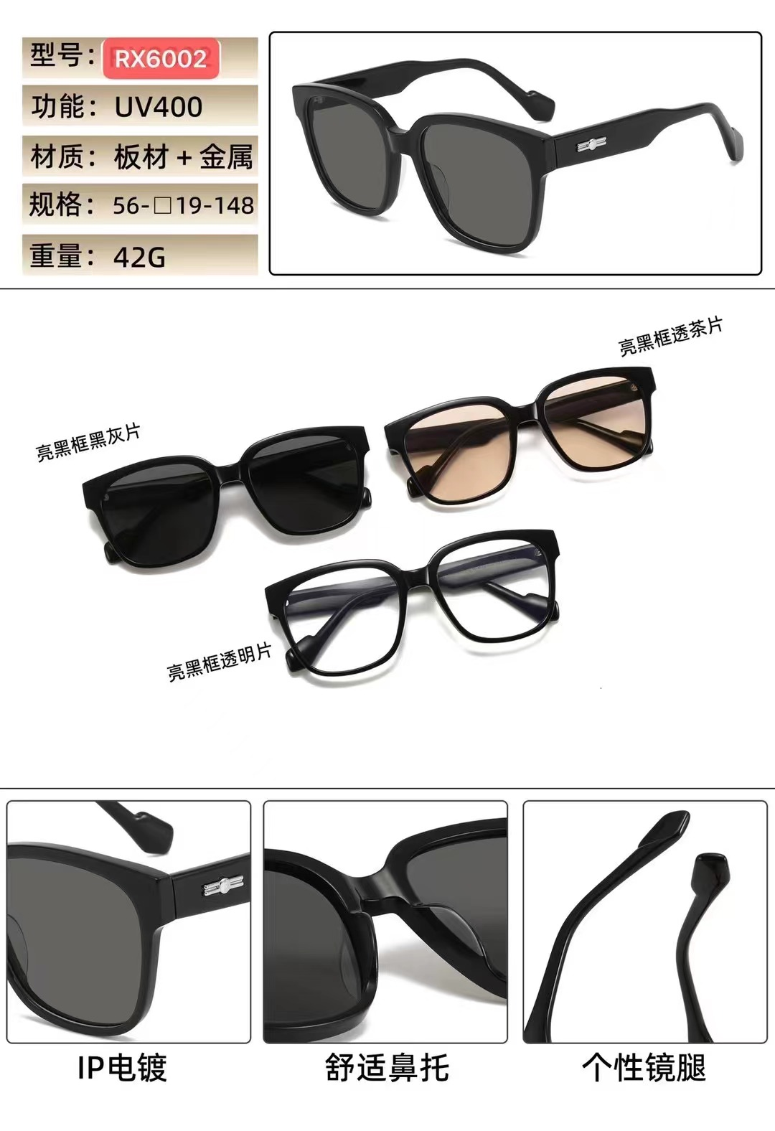
GM KAMIL

Slide 46
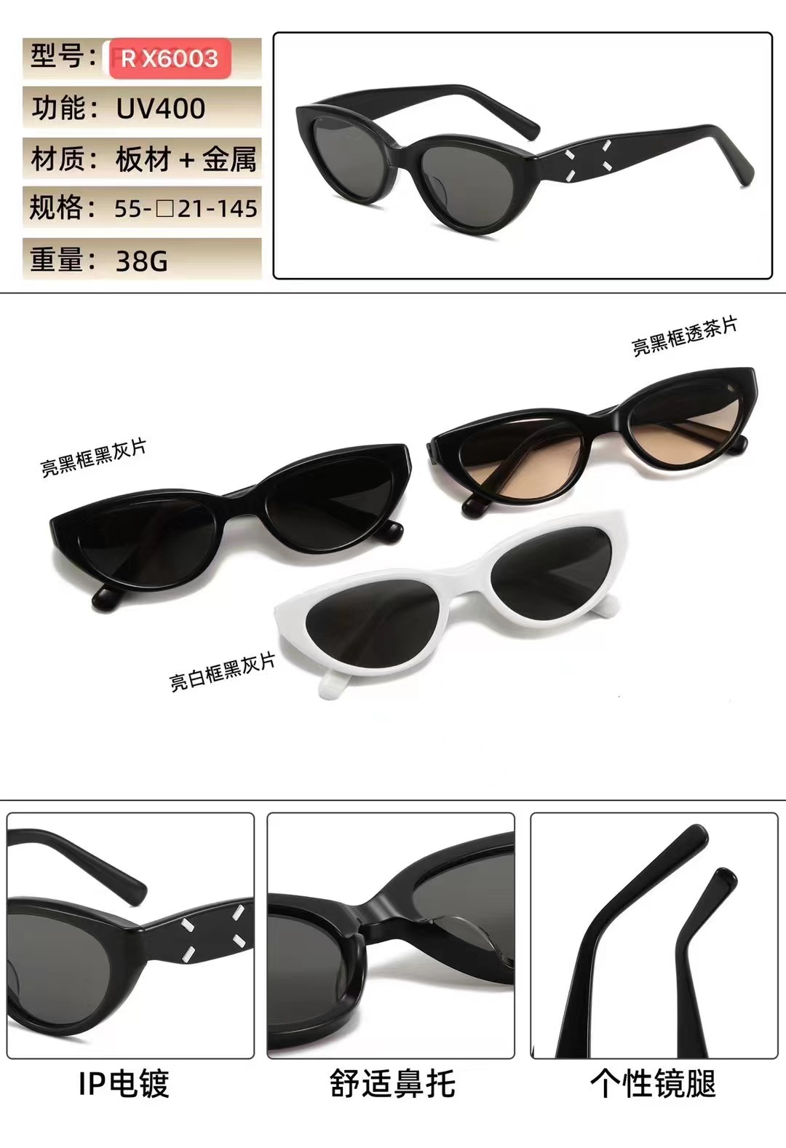
GM MM108

Slide 47
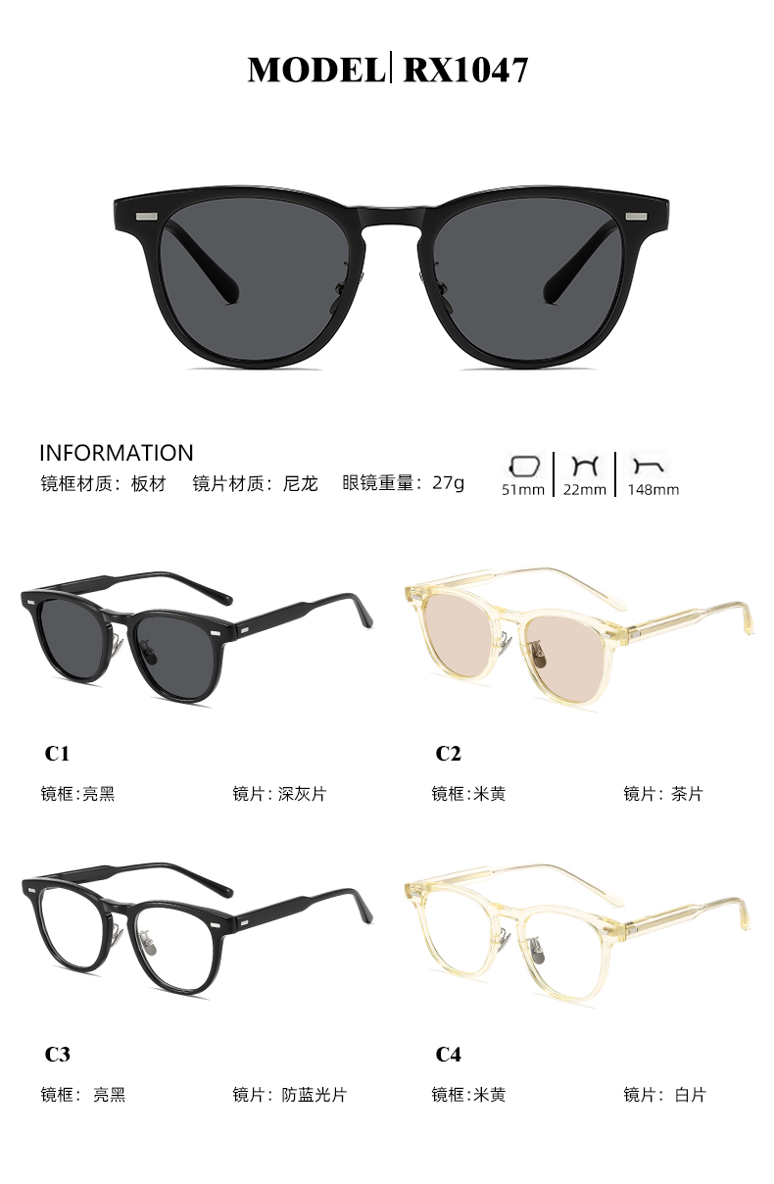
1047

Slide 48
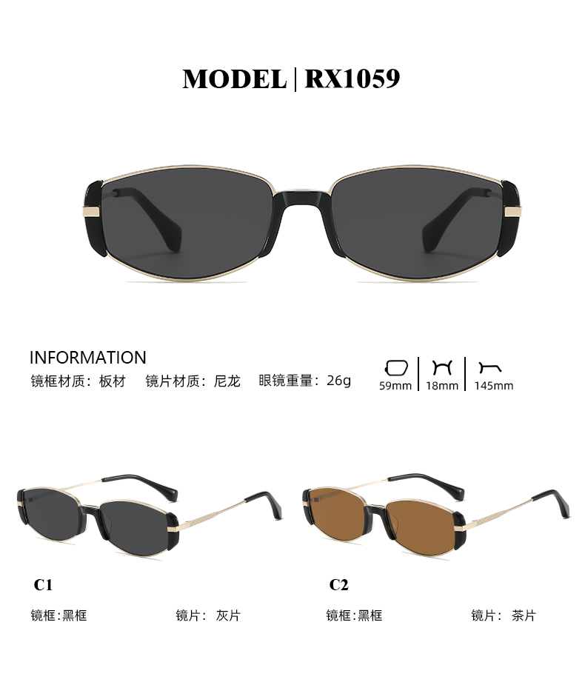
HK606

Slide 49
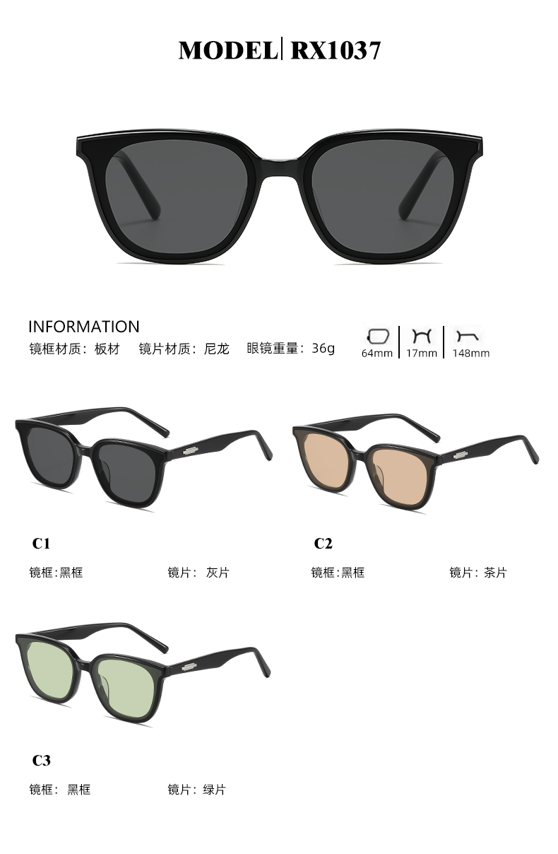
GM LILIT

Slide 50
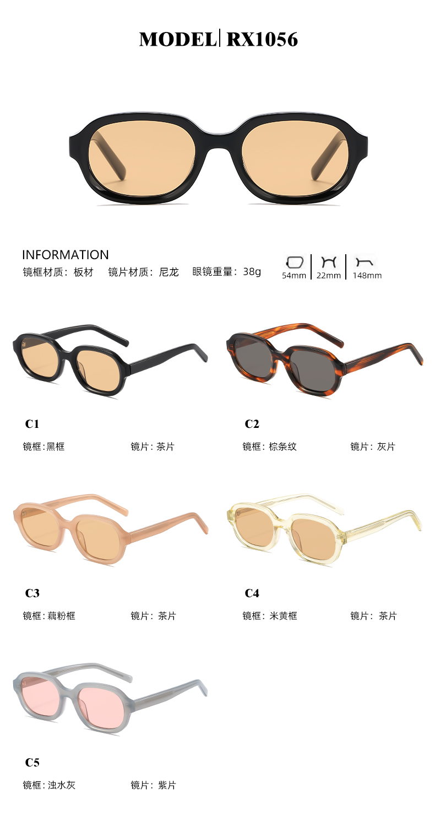
BROWN

Slide 51
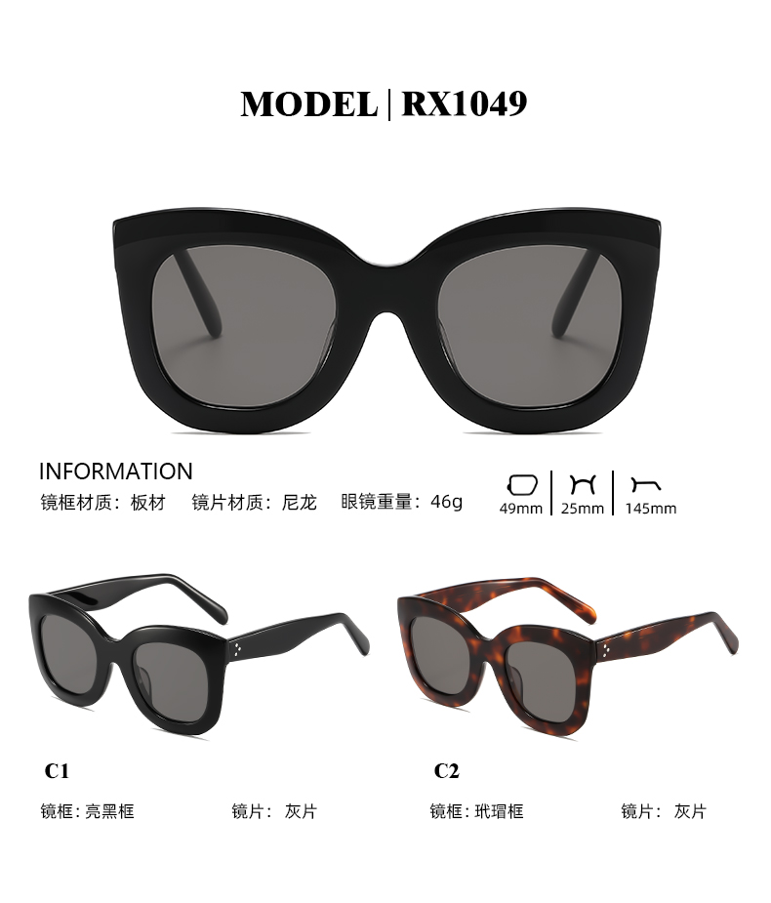
CELINE 4005

Slide 52
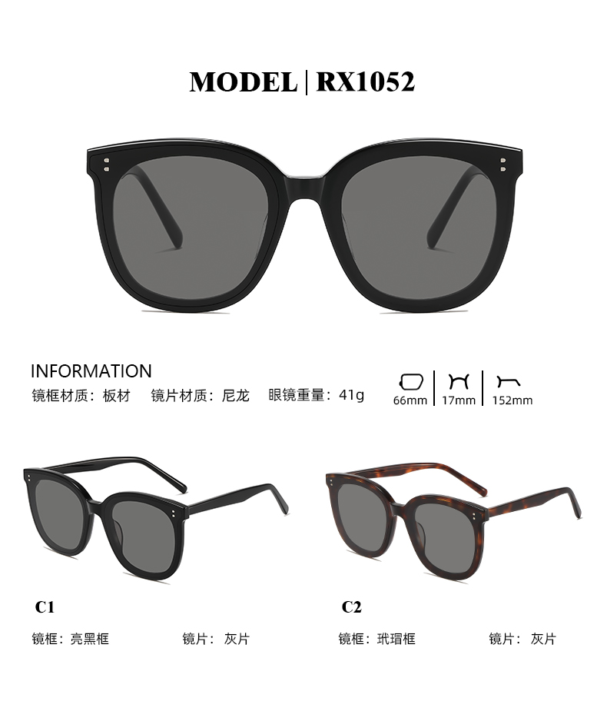
GM My Ma

Slide 53
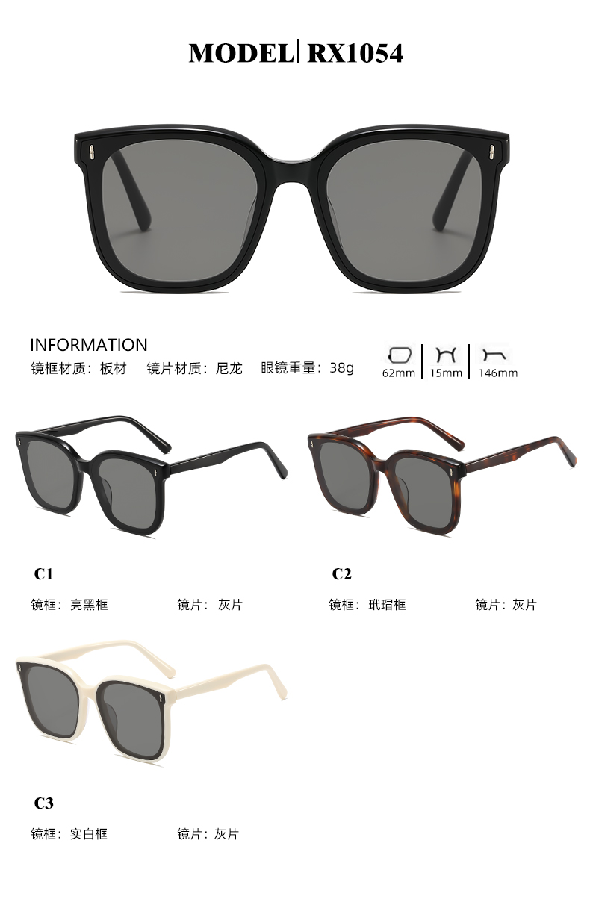
FRIDA

Slide 54
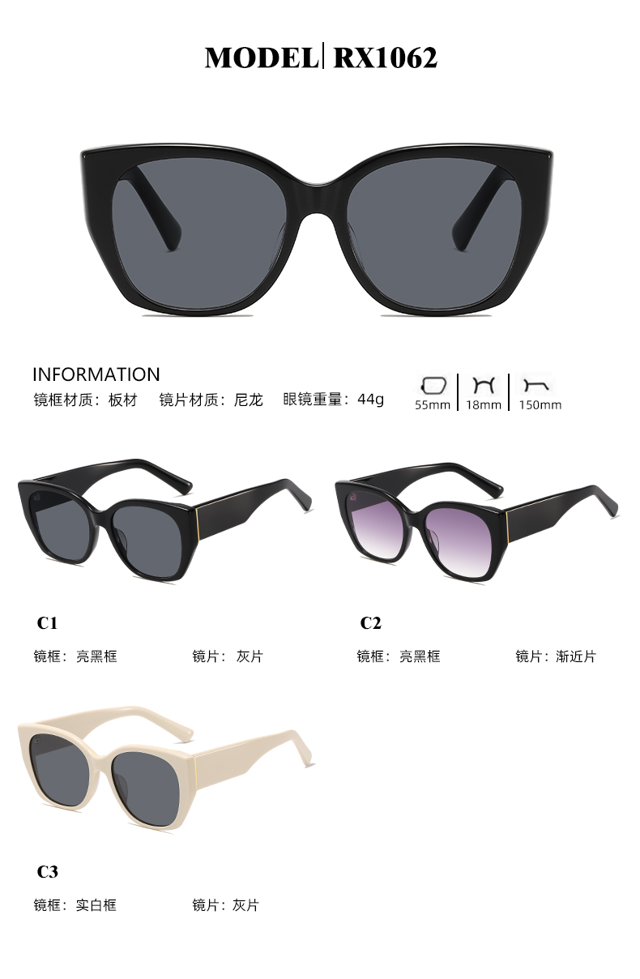
3189

Slide 55
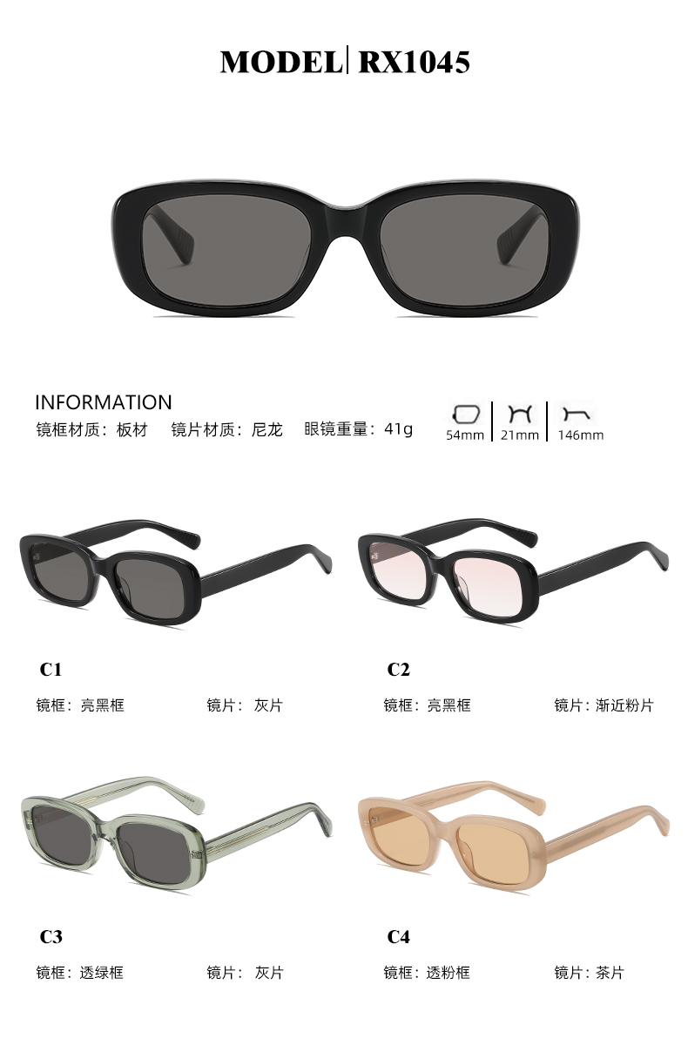
FAKE ME GOTCHA

Slide 56
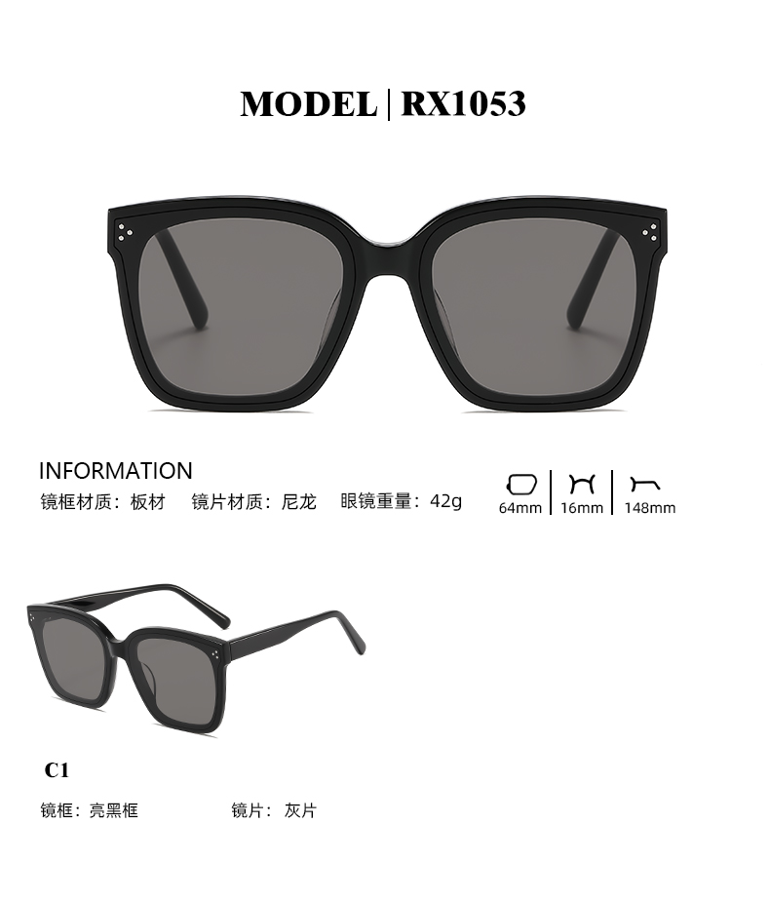
Dreamer17

Slide 57
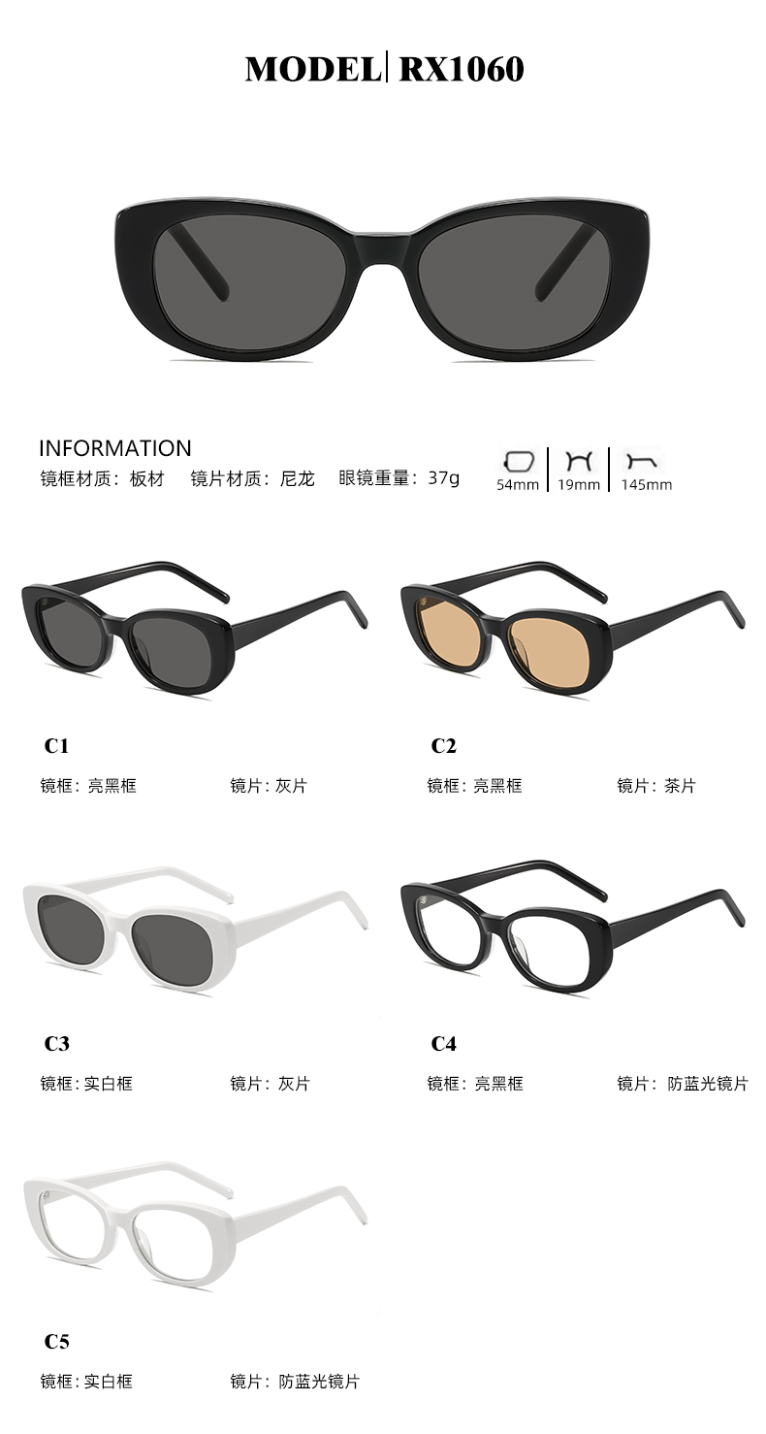
YSL

Slide 58
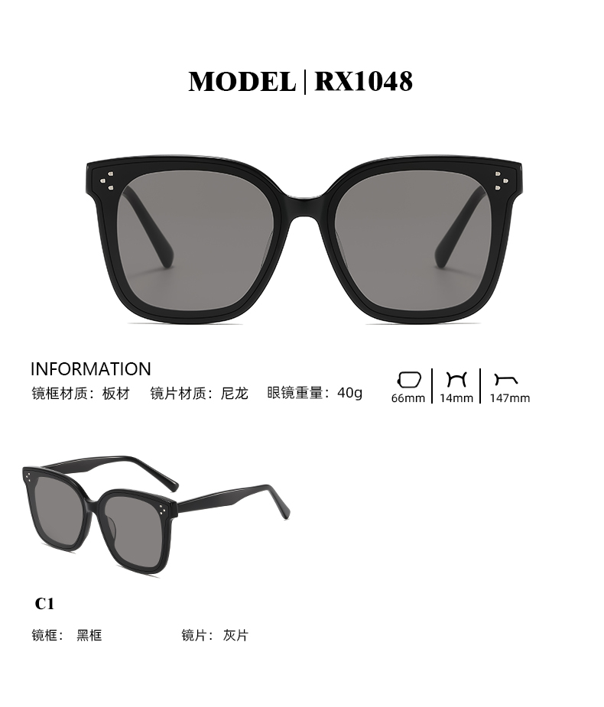
GM HER

Slide 59
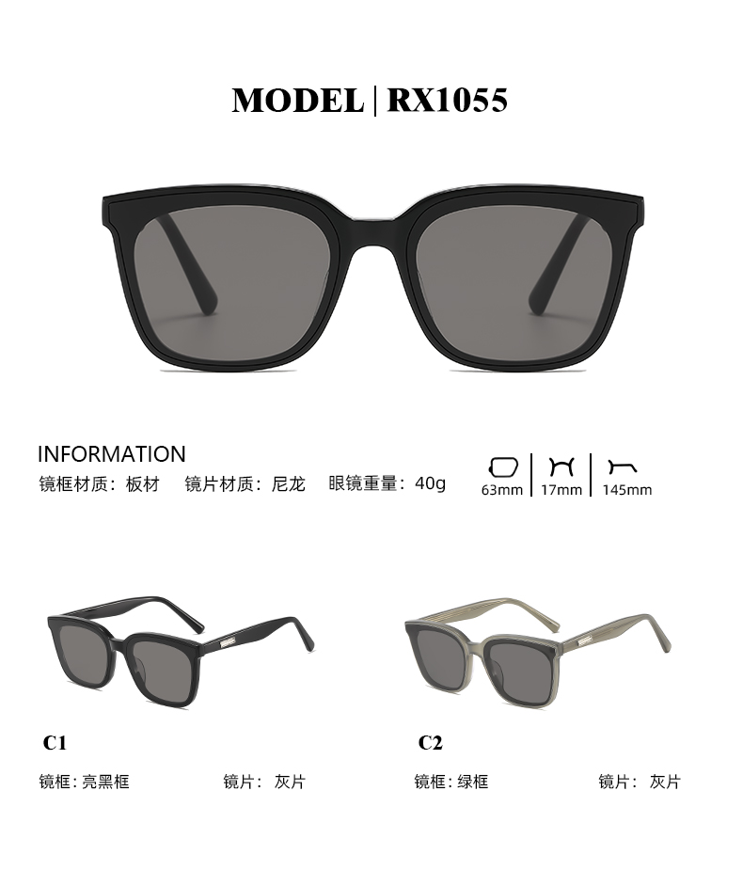
GM PLOT

Slide 60
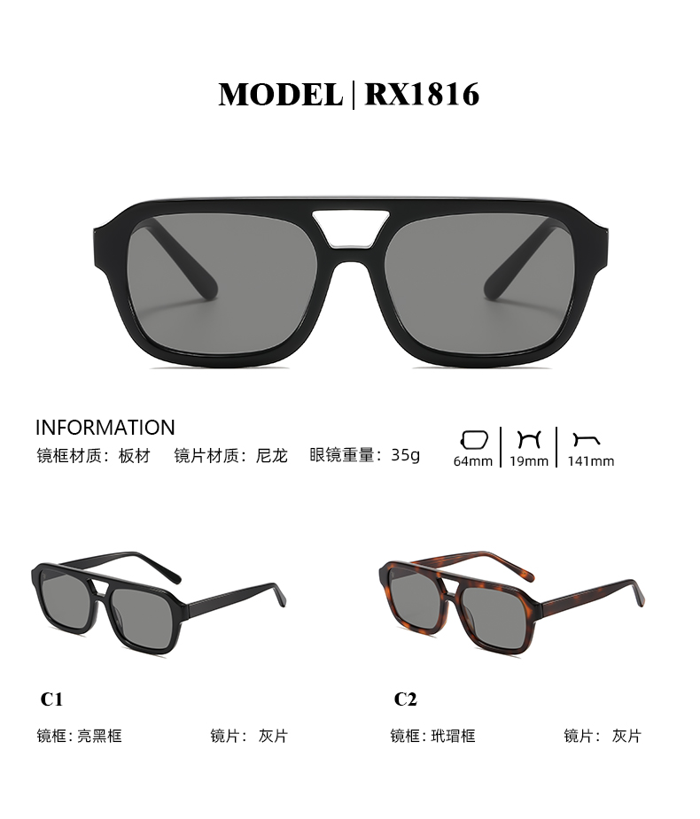
1816

Slide 61
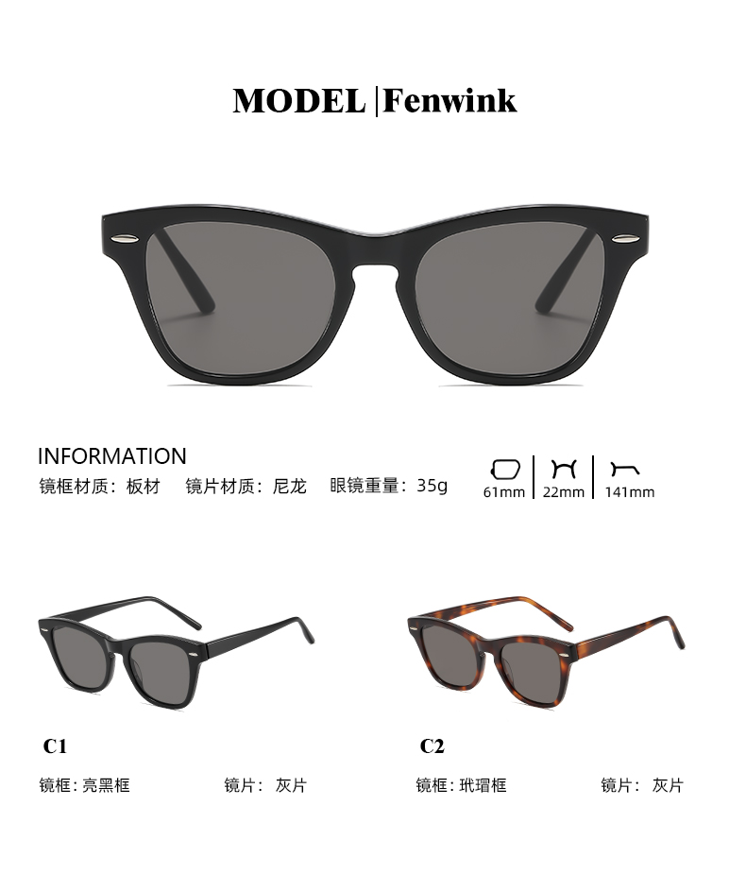

Slide 62
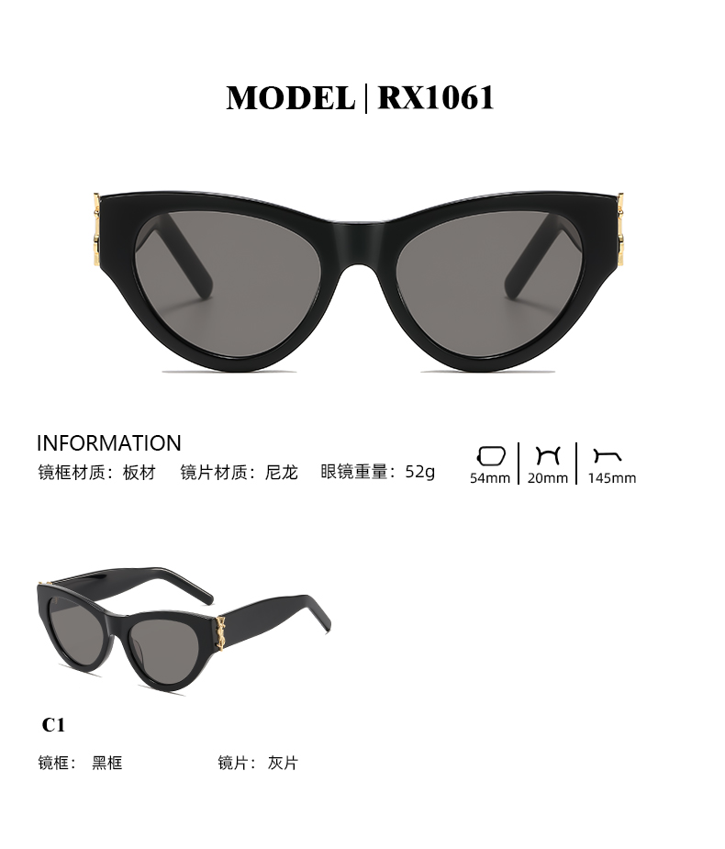
SLM94

Slide 63
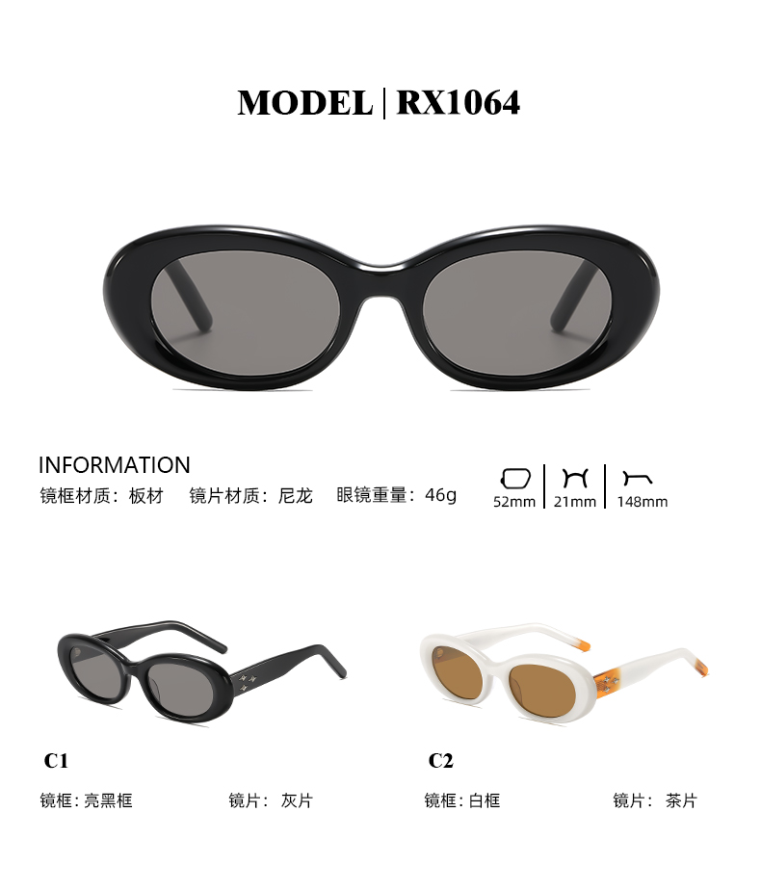
EVE

Slide 64
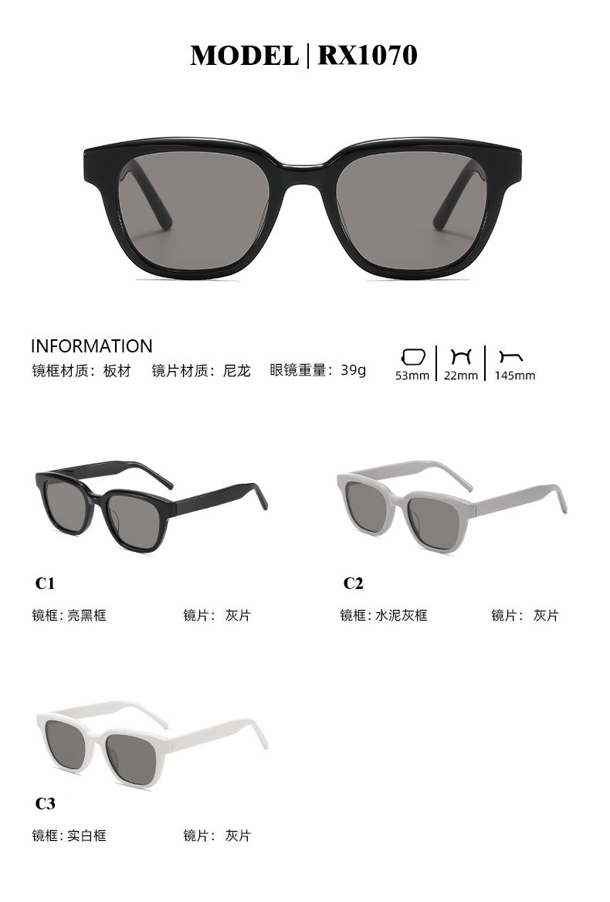
GM MM007

Slide 65
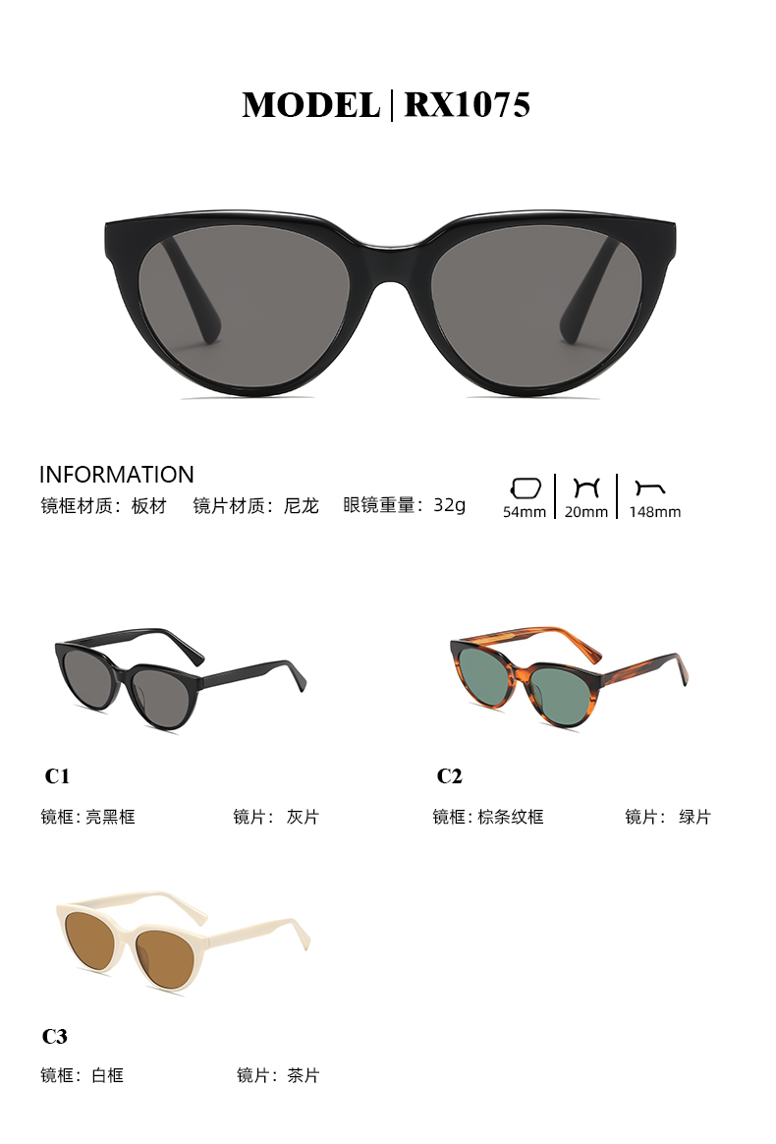
KRISTEN

Slide 66
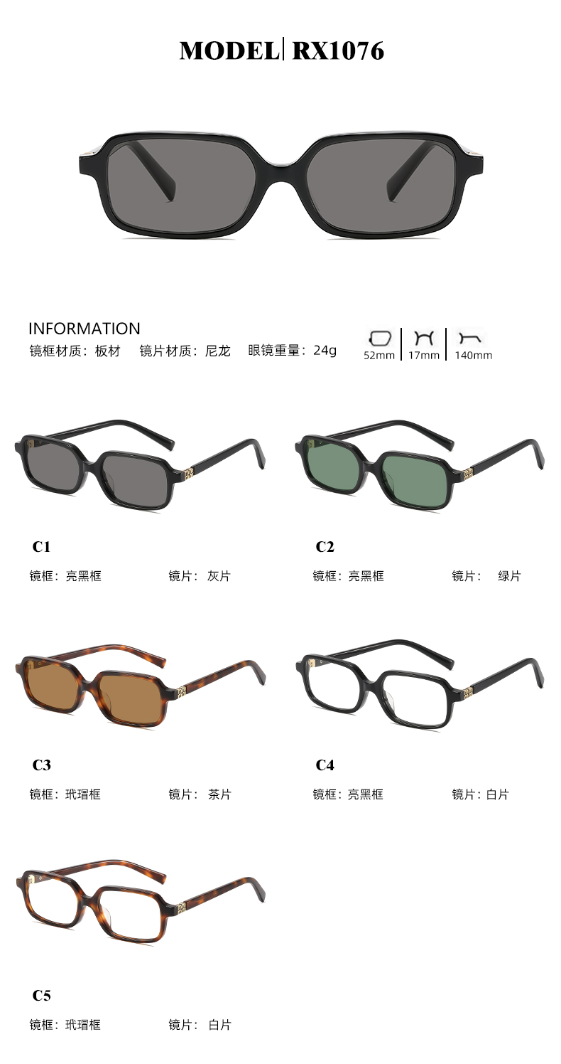
SMU 112S-F

Slide 67

GM 006

Slide 68

1077

Slide 69

SOUTHSIDE

Slide 70

Sound Net

Slide 71

Fakeme quinoa

Slide 72

1079

Slide 73

Bandonenon

Slide 74

UNAC.N

Slide 75

GM NOMA

Slide 76

DIDION

Slide 77

FAKEMEERYK

Slide 78

RX 1078

Slide 79

MS5066

Slide 80


Slide 81


Slide 82

HK707

Slide 83

BILLY

Slide 84

HK808

Slide 85

HK909

Slide 86

SOUTHSIDEN

Slide 87

CELINE

Slide 88

GM SOLID LOOP

Slide 89

SL704

Slide 90

VE4361

Slide 91

SPR B03

Slide 92

CH5488

Slide 93

fakeme Y2K

Slide 94

MS3123

Slide 95

GG 1662SA

Slide 96

GM VEGAX

Slide 97

BB0207S

Slide 98

SLM140

Slide 99

SMU11W

Slide 100

CL4S308U

Slide 101

MM Y2K

Slide 102

SMU06S

Slide 103


Slide 104

fake me nocap

Slide 105

BESLO

Slide 106

GM OAA

Slide 107


Slide 108

5525

Slide 109

MJ12SM1600

Slide 110

2711

Slide 111

CORORI

Slide 112

BX1117

